Slide 1

Software Engineering (CS34102)
Software Life Cycle Model
Course Coordinator:
Prof. (Dr.) D.S. Kushwaha
Course Instructor: Akanksha Gaur
Department of Computer Science and Engineering
MNNIT, Allahabad

Slide 2
Contents
What is Software Life Cycle Models?
Why Software Life Cycle Models?
SDLC Activities
Software Development Paradigms

Slide 3
Software Life Cycle (or Software Development Life Cycle or software process)
Series of identifiable stages that a software product undergoes during its life time:
    Planning
    Analysis
    Design
    Implementation
    Testing & Integration
    Maintenance

Slide 4
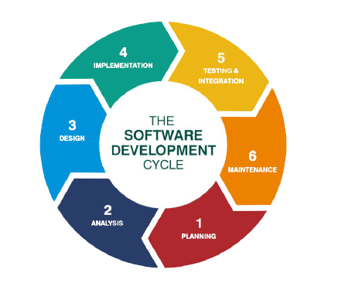
Software Life Cycle (or Software Development Life Cycle or software process)

Slide 5
Software Life Cycle Model
  A descriptive and diagrammatic model of software life cycle:
  Identifies all the activities required for product development
  Establishes a precedence ordering among the different activities
  Divides life cycle into phases

Slide 6
Software Life Cycle Model
Several different activities may be carried out in each life cycle phase.
  For example, the design stage might consist of:
    Structured analysis activity followed by
    Structured design activity

Slide 7
Why Model Life Cycle ?
  Forms a common understanding of activities among the software developers
  It helps in identifying inconsistencies, redundancies, and omissions in the development process
  Helps in tailoring a process model for specific projects
  A documented process model helps to identify where process tailoring is to occur.

Slide 8
Life Cycle Model (CONT.)
The development team must identify a suitable life cycle model and then adhere to it.
Primary advantage of adhering to a life cycle model is that it helps the development of the software in a systematic and disciplined manner.

Slide 9
Life Cycle Model (CONT.)
When a program is developed by a single programmer -
  he has the freedom to decide his exact steps.

Slide 10
Life Cycle Model (CONT.)
When a software product is being developed by a team:
  there must be a precise understanding among team members as to when to do what
  otherwise it would lead to chaos and project failure.

Slide 11
Life Cycle Model (CONT.)
A software project will never succeed if:
  one engineer starts writing code,
  another concentrates on writing the test document first,
  yet another engineer first defines the file structure
  another defines the I/O for his portion first.

Slide 12
Life Cycle Model (CONT.)
A life cycle model:
  defines entry and exit criteria for every phase.
  A phase is considered to be complete:
    only when all its exit criteria are satisfied.

Slide 13
Life Cycle Model (CONT.)
The phase exit criteria for the software requirements specification phase:
  Software Requirements Specification (SRS) document is complete, reviewed, and approved by the customer.
A phase can start:
  only if its phase-entry criteria have been satisfied.

Slide 14
Life Cycle Model (CONT.)
It becomes easier for software project managers:
  to monitor the progress of the project.

Slide 15
SDLC Activities
SDLC provides a series of steps to be followed to design and develop a software product efficiently. SDLC framework includes the following steps:

Slide 16
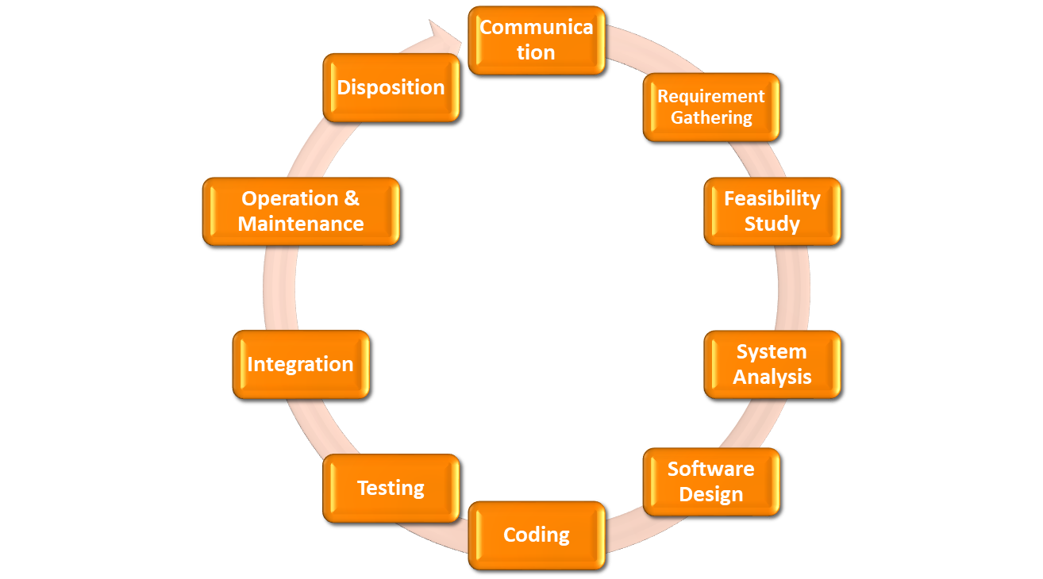
SDLC Activities

Slide 17
Communication
This is the first step where the user initiates the request for a desired software product.
He contacts the service provider and tries to negotiate the terms.
He submits his request to the service providing organization in writing.

Slide 18
Requirement Gathering
This step onwards the software development team works to carry on the project.
The team holds discussions with various stakeholders from problem domain and tries to bring out as much information as possible on their requirements.
The requirements are contemplated and segregated into user requirements, system requirements and functional requirements.

Slide 19
Requirement Gathering
The requirements are collected using a number of practices as given -
Studying the existing or obsolete system and software
Conducting interviews of users and developers
Referring to the database or
Collecting answers from the questionnaires

Slide 20
Feasibility Study
After requirement gathering, the team comes up with a rough plan of software process.
At this step the team analyzes if a software can be made to fulfill all requirements of the user and if there is any possibility of software being no more useful.
It is found out, if the project is financially, practically and technologically feasible for the organization to take up.

Slide 21
System Analysis
At this step the developers decide a roadmap of their plan and try to bring up the best software model suitable for the project.
Understanding of software product limitations, learning system related problems or changes to be done in existing systems beforehand, identifying and addressing the impact of project on organization and personnel etc.
The project team analyzes the scope of the project and plans the schedule and resources accordingly.

Slide 22
Software Design
Bring down whole knowledge of requirements and analysis on the desk and design the software product.
The inputs from users and information gathered in requirement gathering phase are the inputs of this step.
The output of this step comes in the form of two designs; logical design and physical design.
Engineers produce meta-data and data dictionaries, logical diagrams, data-flow diagrams and in some cases pseudo codes.

Slide 23
Coding
This step is also known as programming phase.
The implementation of software design starts in terms of writing program code in the suitable programming language and developing error-free executable programs efficiently.

Slide 24
Testing
Errors may ruin the software from critical level to its own removal.
Software testing is done while coding by the developers and thorough testing is conducted by testing experts at various levels of code such as module testing, program testing, product testing, in-house testing and testing the product at user’s end.
Early discovery of errors and their remedy is the key to reliable software.

Slide 25
Integration
Software may need to be integrated with the libraries, databases and other program(s).
This stage of SDLC is involved in the integration of software with outer world entities.

Slide 26
Implementation
This means installing the software on user machines.
Software needs post-installation configurations at user end.
Software is tested for portability and adaptability and integration related issues are solved during implementation.

Slide 27
Operation and Maintenance
This phase confirms the software operation in terms of more efficiency and less errors.
If required, the users are trained on, or aided with the documentation on how to operate the software and how to keep the software operational.
The software is maintained timely by updating the code according to the changes taking place in user end environment or technology.
It may face challenges from hidden bugs and real-world unidentified problems.

Slide 28
Disposition
As time elapses, the software may decline on the performance front. It may go completely obsolete or may need intense upgradation.
Hence a pressing need to eliminate a major portion of the system arises.
This phase includes archiving data and required software components, closing down the system, planning disposition activity and terminating system at appropriate end-of-system time.

Slide 29
Life Cycle Model (CONT.)
Many life cycle models have been proposed. We will confine our attention to a few important and commonly used models.
  Waterfall Model
  Iterative waterfall Model
  Evolutionary Model
  Prototyping Model
  Spiral Model
  V-Shaped Model

Slide 30

Life Cycle Model (CONT.)
Waterfall Model
Iterative Waterfall Model
Evolutionary Model
Prototyping Model
Spiral Model
V- Shaped Model

Slide 31
Waterfall Model
The whole process of software development is divided into separate phases.
The outcome of one phase acts as the input for the next phase sequentially.

Slide 32
Waterfall Model
Feasibility Study
Requirement Analysis and Specification
Design
Coding and
Unit Testing
Integration and System Testing
Maintenance

Slide 33
Advantages
Simple and is easy to understand.
Phases in this model are processed one at a time.
Each stage in the model is clearly defined.
Very clear and well understood milestones.

Slide 34
Advantages
Process, actions and results are very well documented
Reinforces good habits: define-before- design
Design-before-code
Works well for smaller projects and projects where requirements are well understood

Slide 35
Disadvantages
No working software is produced until late during the life cycle.
High amounts of risk and uncertainty.
Not a good model for complex and object-oriented projects.
Poor model for long and ongoing projects.
It is difficult to measure progress within stages.

Slide 36
Disadvantages
Not suitable for the projects where requirements are at a moderate to high risk of changing. So, risk and uncertainty is high.
Cant accommodate changing requirements.
Adjusting scope can end a project.
Integration is done as a "big-bang. at the very end, which doesn't allow identifying any technological or business bottleneck or challenges early.

Slide 37
Applications
Requirements are very well documented, clear and fixed.
Product definition is stable.
Technology is understood and static.
There are no ambiguous requirements.
Ample resources with required expertise are available to support the product.
The project is short.

Slide 38
Iterative Waterfall Model
It can be thought of as incorporating the necessary changes to the classical waterfall model to make it usable in practical software development projects.
It provides feedback paths from every phase to its preceding phases, which is the main difference from the classical waterfall model.

Slide 39
Iterative Waterfall Model
When errors are detected at some later phase, feedback paths allow correcting it.
There is no feedback path to the stage – feasibility study, because once a project has been taken, does not give up the project easily.
The principle of detecting errors as close to their points of commitment as possible is known as Phase containment of errors.

Slide 40
Iterative Waterfall Model
Feasibility Study
Requirement Analysis and Specification
Design
Coding and
Unit Testing
Integration and System Testing
Maintenance

Slide 41
Advantages
Allows the mechanism of error connection because there is a feedback path from one phase to its preceding phase which it lacks in the Waterfall Model.
Simple to understand and use.
Parallel development can be done.

Slide 42
Disadvantages
Difficult to incorporate change requests
Incremental delivery not supported
Overlapping of phases not supported
Risk handling not supported
Limited customer interactions
Not suitable for a small project

Slide 43
Applications
Major requirements are defined.
New technologies are being used and there is a learning curve for the programmers to learn.
Resource are limited to do a huge project as if a small project automates are in contact rather than permanent.
Very high risk as a goal of the project might change from time to time.

Slide 44
Evolutionary Model
Evolutionary model is a combination of Iterative and Incremental model of software development life cycle.
Delivering your system in a big bang release, delivering it in incremental process over time is the action done in this model.
Some initial requirements and architecture envisioning need to be done.

Slide 45
Evolutionary Model
Specification
Initial Version
Online Description
Development
Intermediate Versions
Validation
Final Version

Slide 46
Advantages
User gets a chance to experiment with a partially developed software much before the complete version of the system is released.
Helps to accurately elicit user requirements during the delivery of different versions of the software.
Less chance of errors.
Avoids the need to commit large resources in one go for development of the system.

Slide 47
Disadvantages
Difficult to divide the problem into several versions that would be acceptable to the customer and which can be incrementally implemented and delivered.

Slide 48
Applications
For very large products, where it is easier to find modules, for incremental implementation.
When the customer prefers to receive the product in increments so that he can start using the different features as and when they are developed rather than waiting all the time for the full product to be developed and delivered.

Slide 49
Prototyping Model
This model is used when the customers do not know the exact project requirements beforehand.
A prototype of the end product is first developed, tested and refined as per customer feedback repeatedly till a final acceptable prototype is achieved which forms the basis for developing the final product.

Slide 50
Prototyping Model
The system is partially implemented before or during the analysis phase thereby giving the customers an opportunity to see the product early in the life cycle.
The process starts by interviewing the customers and developing the incomplete high-level paper model.

Slide 51
Prototyping Model
This document is used to build the initial prototype supporting only the basic functionality as desired by the customer.
Once the customer figures out the problems, the prototype is further refined to eliminate them.
The process continues until the user approves the prototype and finds the working model to be satisfactory.

Slide 52
Prototyping Model
Start
Requirement gathering
Quick Design
Building Prototype
Stop
Engineered Product
Refining Prototype
Customer Evaluation

Slide 53
Types of Prototyping Model
Rapid Throwaway Prototyping
Evolutionary Prototyping
Incremental Prototyping
Extreme Prototyping

Slide 54
Rapid Throwaway Prototyping
This technique offers a useful method of exploring ideas and getting customer feedback for each of them.
In this method, a developed prototype need not necessarily be a part of the ultimately accepted prototype.
Customer feedback helps in preventing unnecessary design faults and hence, the final prototype developed is of better quality.

Slide 55


Rapid Throwaway Prototyping
Outline Requirements
Develop Prototype
Evaluate Prototype
Customer Evaluation
Reusable Components
Delivered Software System
Develop Software
Validate System

Slide 56
Evolutionary Prototyping
The prototype developed is incrementally refined on the basis of customer feedback till it finally gets accepted.
In comparison to Rapid Throwaway Prototyping, it offers a better approach which saves time as well as effort.
Because developing a prototype from scratch for every iteration of the process can sometimes be frustrating for the developers.

Slide 57

Evolutionary Prototyping
Initial
Requirements
Design & Development
Feedback with new requirements
No
User Validation
User Acceptance
Yes
Delivery System

Slide 58
Incremental Prototyping
The final expected product is broken into different small pieces of prototypes and being developed individually.
In the end, when all individual pieces are properly developed, then the different prototypes are collectively merged into a single final product in their predefined order.

Slide 59
Incremental Prototyping
The time interval between the project begin and final delivery is substantially reduced because all parts of the system are prototyped and tested simultaneously.
There might be the possibility that the pieces just not fit together due to some lack ness in the development phase – this can only be fixed by careful and complete plotting of the entire system before prototyping starts.

Slide 60
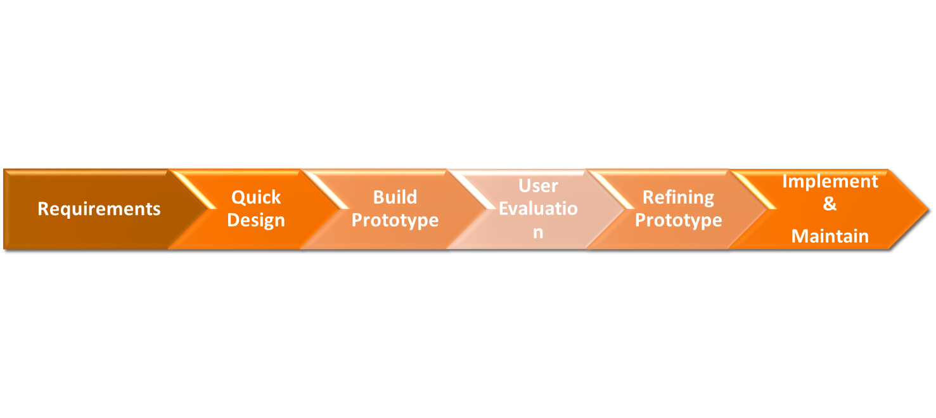
Incremental Prototyping

Slide 61
Extreme Prototyping
It’s used for web development. It is consists of three sequential independent phases:
D.1) In this phase a basic prototype with all the existing static pages are presented in the HTML format.
D.2) In the 2nd phase, Functional screens are made with a simulate data process using a prototype services layer.

Slide 62
Extreme Prototyping
D.3) This is the final step where all the services are implemented and associated with the final prototype.
This method makes the project cycling and delivery robust and fast, and keeps the entire developer team focus centralized on products deliveries rather than discovering all possible needs and specifications and adding unnecessary features.

Slide 63
Advantages – Prototyping Model
The customers get to see the partial product early in the life cycle.
Greater level of customer satisfaction and comfort.
New requirements can be easily accommodated as there is scope for refinement.
Missing functionalities can be easily figured out.

Slide 64
Advantages – Prototyping Model
Errors can be detected much earlier thereby saving a lot of effort and cost, besides enhancing the quality of the software.
The developed prototype can be reused by the developer for more complicated projects in the future.
Flexibility in design.

Slide 65
Disadvantages – Prototyping Model
Costly w.r.t time as well as money.
High variation in requirements each time the prototype is evaluated by the customer.
Poor Documentation due to continuously changing customer requirements.
It is very difficult for developers to accommodate all the changes demanded by the customer.

Slide 66
Disadvantages – Prototyping Model
Uncertainty in determining the number of iterations required before the prototype is finally accepted by the customer.
After seeing an early prototype, the customers sometimes demand the actual product to be delivered soon.
Developers in a hurry to build prototypes may end up with sub-optimal solutions.

Slide 67
Applications – Prototyping Model
When the requirements of the product are not clearly understood or are unstable.
If requirements are changing quickly.
Developing user interfaces, high technology software-intensive systems, and systems with complex algorithms and interfaces.
It is also a very good choice to demonstrate the technical feasibility of the product.

Slide 68
Spiral model
It combines the idea of iterative development with the systematic, controlled aspects of the waterfall model.
It’s a combination of iterative development process model and sequential linear development.
It allows incremental releases of the product or incremental refinement through each iteration around the spiral.

Slide 69
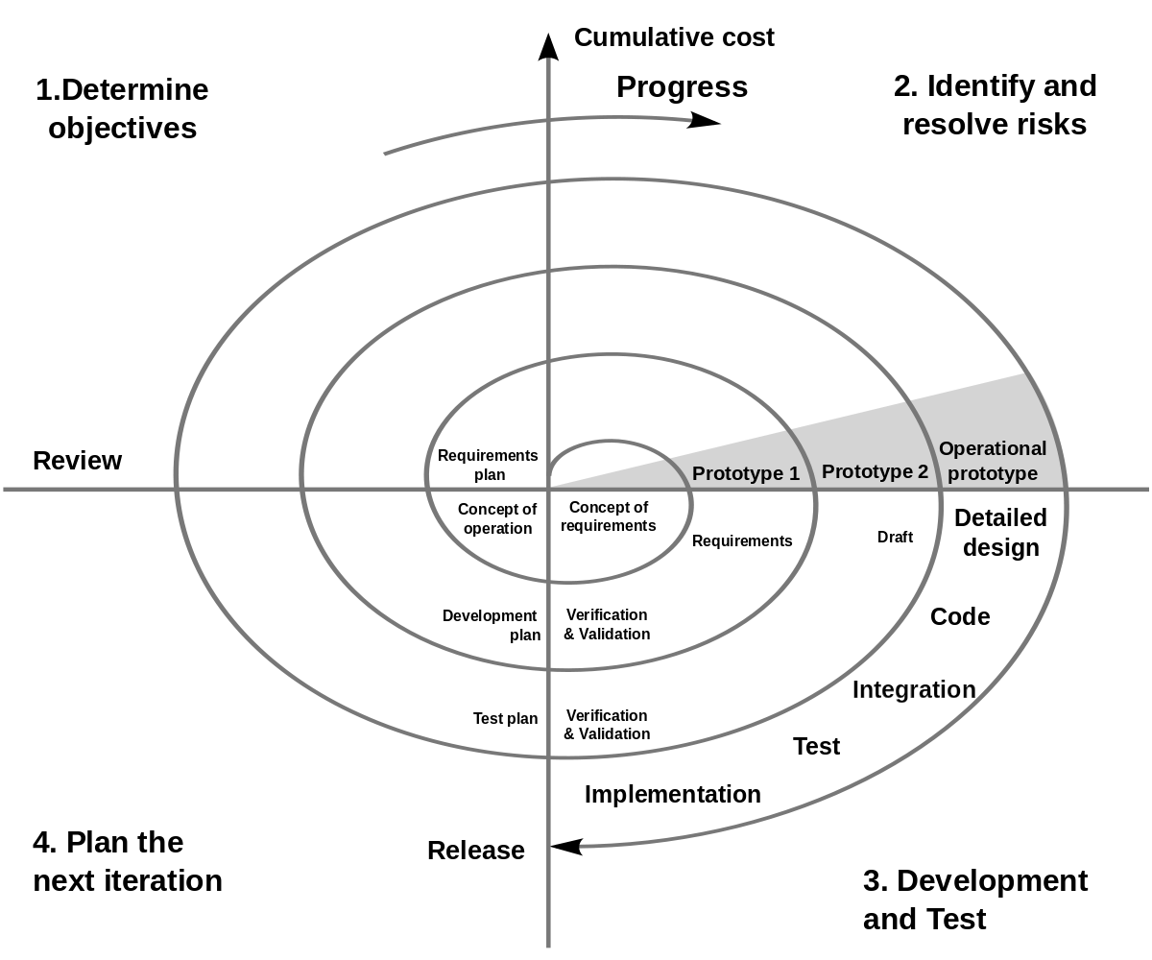
Spiral model

Slide 70
Spiral model - Phases
A software project repeatedly passes through some phases in iterations called Spirals.
The spiral model has four phases.
    Identification
    Design
    Construct or Build
    Evaluation and Risk Analysis

Slide 71
Identification
Gather business requirements in the baseline spiral.
In the subsequent spirals, as the product matures, identify system, subsystem and unit requirements.
Understanding system requirements by continuous communication between the customer and the system analyst. At the end of the spiral, the product is deployed in the identified market.

Slide 72
Design
It starts with the conceptual design in the baseline spiral and involves architectural design, logical design of modules, physical product design and the final design in the subsequent spirals.

Slide 73
Construct or Build
Production of the actual software product at every spiral.
In the baseline spiral, when the product is just thought of and the design is being developed a Proof of Concept is developed in this phase to get customer feedback.
In the subsequent spirals with higher clarity on requirements and design details a working model of the software called build is produced with a version number. These builds are sent to the customer for feedback.

Slide 74
Evaluation and Risk Analysis
It includes identifying, estimating and monitoring the technical feasibility and management risks.
After testing the build, at the end of first iteration, the customer evaluates the software and provides feedback.
The software development process enters the next iteration and subsequently follows the linear approach to implement the feedback suggested by the customer.
The process of iterations along the spiral continues throughout the life of the software.

Slide 75
Advantages
Handles changing requirements.
Allows extensive use of prototypes.
Requirements captured more accurately.
Users see the system early.
Development can be divided into smaller parts and the risky parts can be developed earlier which helps in better risk management.

Slide 76
Disadvantages
Management is more complex.
End of the project may not be known early.
Not suitable for small or low risk projects and could be expensive for small projects.
Process is complex
Spiral may go on indefinitely.
Large number of intermediate stages requires excessive documentation.

Slide 77
Applications
When there is a budget constraint and risk evaluation is important.
For medium to high-risk projects.
Long-term project commitment because of potential changes to economic priorities as the requirements change with time.
Customer is not sure of their requirements which is usually the case.

Slide 78
Applications
Requirements are complex and need evaluation to get clarity.
New product line which should be released in phases to get enough customer feedback.
Significant changes are expected in the product during the development cycle.

Slide 79
V-Shaped Model
It’s an expansion of classic waterfall model and it’s based on associated test stage for the every development stage.
It’s a very strict model and the next stage is started only after the previous phase.
This is also called “Validation and verification” model. Every stage has the current process control, to make sure that the conversion to the next stage is possible.

Slide 80
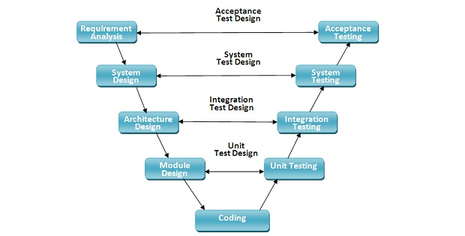
V-Shaped Model

Slide 81
Advantages
Every stage of V-shaped model has strict results so it’s easy to control
Testing and verification take place in the early stages
Good for the small projects, where requirements are static and clear

Slide 82
Disadvantages
Lack of flexibility.
Bad choice for small projects
Relatively big risks

Slide 83
Applications
For the projects where an accurate product testing is required
For the small and mid-sized projects, where requirements are strictly predefined
The engineers of the required qualification, especially testers, are within easy reach.

Slide 84
Rapid Application Development model
RAD Model is a software development process based on prototyping without any specific planning.
In this model, there is less attention paid to the planning and more priority is given to the development tasks.
It targets at developing software in a short span of time.

Slide 85
Rapid Application Development model
It focuses on input-output source and destination of the information.
It emphasizes on delivering projects in small pieces; the larger projects are divided into a series of smaller projects.
The main features of RAD modeling are that it focuses on the reuse of templates, tools, processes, and code.

Slide 86
Rapid Application Development model
It has following phases
  Requirement Planning Phase
  User Description
  Construction Phase
  Cut Over Phase

Slide 87
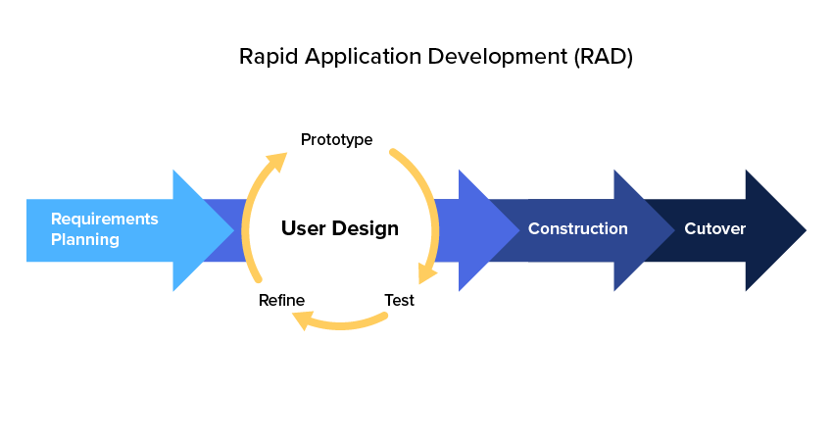

Slide 88
Advantages
Flexible and adaptable to changes
Due to prototyping in nature, there is a possibility of lesser defects
Each phase in RAD delivers highest priority functionality to client
With less people, productivity can be increased in short time
Encourages customer feedback.

Slide 89
Advantages
Useful in reducing the overall project risk
Changing requirements can be accommodated.
Progress can be measured.
Iteration time can be short with use of powerful RAD tools.
Productivity with fewer people in a short time.
Quick initial reviews

Slide 90
Advantages
Reduced development time
Increases reusability of components
Integration from very beginning solves a lot of integration issues
Easier to transfer deliverables as scripts, high-level abstractions and intermediate codes are used
Due to code generators and code reuse, there is a reduction of manual coding

Slide 91
Disadvantages
It can't be used for smaller projects
Not all application is compatible with RAD
When technical risk is high, it is not suitable
If developers are not committed to delivering software on time, RAD projects can fail
Reduced features due to time boxing, where features are pushed to a later version to finish a release in short period

Slide 92
Disadvantages
Reduced scalability occurs because a RAD developed application begins as a prototype and evolves into a finished application
Progress and problems accustomed are hard to track as such there is no documentation to demonstrate what has been done
Requires highly skilled designers or developers

Slide 93
Disadvantages
Dependency on technically strong team members for identifying business requirements.
Only system that can be modularized can be built using RAD.
Requires highly skilled developers/designers.
High dependency on Modelling skills.
Management complexity is more.

Slide 94
Disadvantages
Inapplicable to cheaper projects as cost of Modelling and automated code generation is very high.
Suitable for systems that are component based and scalable.
Requires user involvement throughout the life cycle.
Suitable for project requiring shorter development times.

Slide 95
Applications
When a system needs to be produced in a short span of time (2-3 months)
When the requirements are known
When the user will be involved all through the life cycle

Slide 96
Applications
When technical risk is less
When there is a necessity to create a system that can be modularized in 2-3 months of time
When a budget is high enough to afford designers for modeling along with the cost of automated tools for code generation

Slide 97
Agile SDLC Model
In the agile methodology after every development iteration, the customer is able to see the result and understand if he is satisfied with it or he is not.
Extreme programming is one of the practical use of the agile model. The basis of such model consists of short weekly meetings – Sprints which are the part of the Scrum approach.

Slide 98
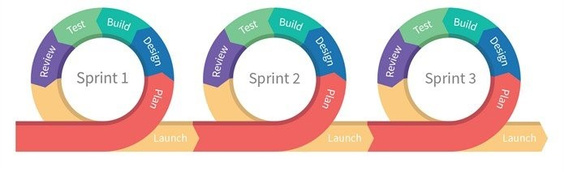
Agile SDLC Model

Slide 99
Advantages
Corrections of functional requirements are implemented into the development process to provide the competitiveness
Project is divided by short and transparent iterations
Risks are minimized thanks to the flexible change process
Fast release of the first product version

Slide 100
Disadvantages
Difficulties with measuring the final cost because of permanent changes
The team should be highly professional and client-oriented
New requirements may conflict with the existing architecture
With all the corrections and changes there is possibility that the project will exceed expected time

Slide 101
Applications
The users need change dynamically
Less price for the changes implemented because of the many iterations
Unlike the Waterfall model, it requires only initial planning to start the project

Slide 102
References
Software Engineering – A Practitioner’s Approach, by Pressman R.S. and Ince D
Software Engineering by Sommerville
Software Engineering Volume 1 and Volume 2 by Thayer and Christiansen
Fundamentals of Software Engineering by Rajib Mall

